Slide 1

Visualizing Employee Attendance Trends with Excel Charts
STUDENT NAME:: Dowlath farjana.A
REGISTER NO:312207772
DEPARTMENT: Bcom general
COLLEGE: The quadie milleth college for men .

Slide 2

PROJECT TITLE
Visualizing Employee Attendance Trends
with Excel Charts

Slide 3


AGENDA
Problem Statement
Project Overview
End Users
Our Solution and Proposition
Dataset Description
Modelling Approach
Results and Discussion
Conclusion
3/21/2024 Annual Review

Slide 4

PROBLEM STATEMENT
1. Monitor attendance rates over time for individual employees and
2. Compare attendance performance across departments and locations.
3. Identify top performers and employees with poor attendance records.
4. Detect patterns and anomalies in attendance data, such as seasonal fluctuations or unusual absences.
5. Communicate insights and trends to management and team leaders to inform data-driven decisions.

Slide 5

PROJECT OVERVIEW
Employee Attendance Trends Visualization
Objective: Track and analyze employee attendance trends
Deliverables: Excel dashboard, user guide, data dictionary
KPIs: Attendance Rate, Absenteeism Rate, Average Days Absent
Top Performers and Poor Attendance Records
Timeline: 10 days
Resources: Excel software, HR attendance data
Project team: HR manager, data analyst, Excel expert
Create an interactive and dynamic Excel dashboard
Enable HR managers to make data-driven decisions

Slide 6

WHO ARE THE END USERS?
Here are the end users of the Employee Attendance Trends Visualization projects:
1. HR Managers
2. Team Leaders
3. Department Heads
4. Operations Managers
5. Business Analysts
6. Management Team
7. Supervisors
8. Employee Relations Specialists
9. Payroll Managers
10. Decision-makers who need attendance insights

Slide 7

OUR SOLUTION AND ITS VALUE PROPOSITION
*Solution:* Interactive Excel dashboard visualizing employee attendance trends and patterns.
*Value Proposition:*
- Improve attendance tracking and analysis
- Inform data-driven decisions
- Boost productivity and reduce absenteeism
- Enhance employee management and insights
- Save time and reduce costs
This solution helps organizations better understand and manage employee attendance, leading to improved productivity, reduced costs, and enhanced workforce insights.

Slide 8
Dataset Description
_Data Set:_ Employee Attendance Records
_Fields:_
+ Employee ID
+ Name
+ Department
+ Location
+ Date
+ Attendance Status (Present, Absent, Late, Left Early)
+ Reason for Absence (optional)
_Format:_
+ Date: MM/DD/YYYY
+ Attendance Status: Categorical
_Volume:_
+ 100-1000+ employees
+ 1000-10,000+ attendance records
+ 1-2 years of data

Slide 9

THE "WOW" IN OUR SOLUTION
*"Wow" Factor: Uncover Hidden Attendance Trends & Patterns with Interactive Excel Charts!
*Key "Wow" Elements:
1. *Live Attendance Dashboards*: Real-time insights into employee attendance trends.
2. *Predictive Analytics*: Forecast absenteeism and identify areas for improvement.
3. *Customizable Charts*: Personalized views for HR, management, and employees.
4. *Automated Reporting*: Scheduled reports for timely decision-making.
5. *Data-Driven Insights*: Uncover hidden trends and correlations to inform HR strategy.
*Impact:* Boost productivity, reduce absenteeism, and enhance employee management with data-driven decisions!
3/21/2024 Annual Review
9

Slide 10

MODELLING
Data Modeling:
- Source: HR attendance records
- Transformation: Clean, format, and aggregate data
- Visualization: Interactive Excel charts and dashboards
Key Models:
- Attendance Rate
- Absenteeism
- Predictive
- Correlation
10

Slide 11
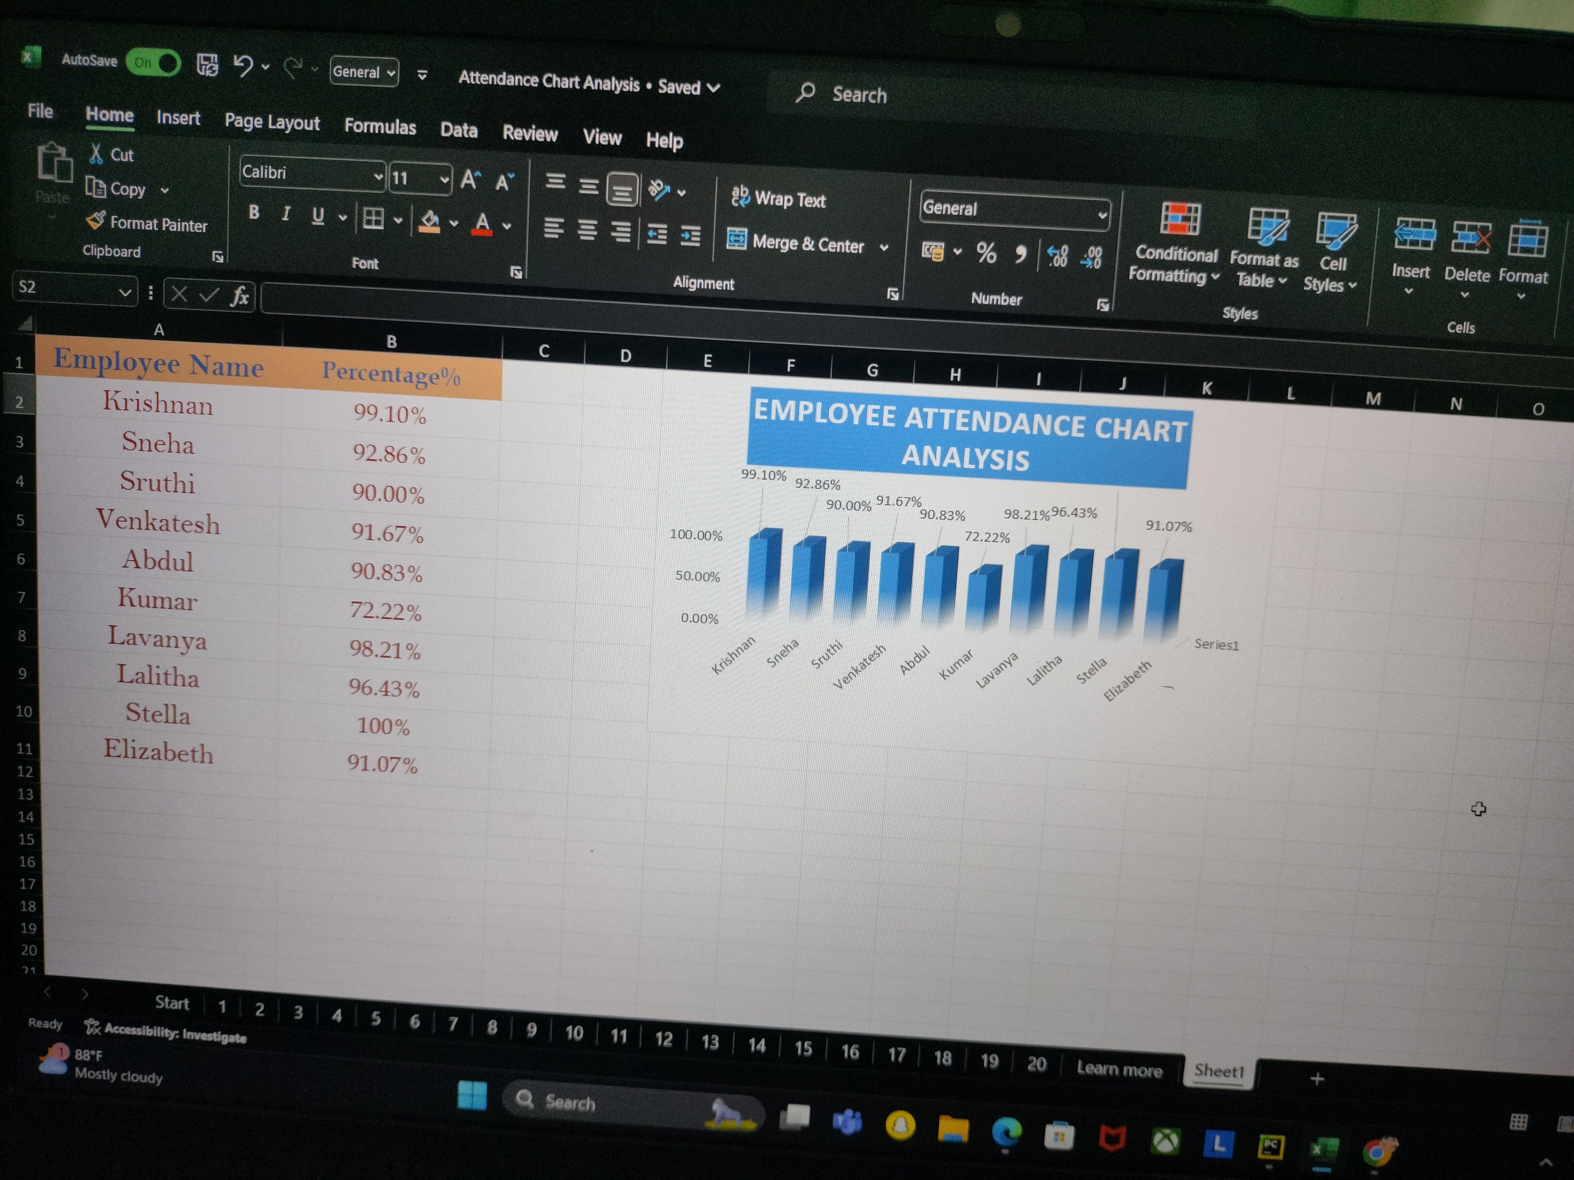
RESULTS
11

Slide 12
conclusion
Visualizing employee attendance trends with Excel charts allows for a straightforward analysis of attendance patterns over time. By leveraging Excel’s charting tools, such as line graphs or bar charts, you can effectively track key metrics, identify trends, and spot any anomalies in attendance data. This visual approach simplifies complex data, making it easier to interpret and use for informed decision-making. Consequently, it enhances workforce management by providing clear insights into attendance behaviors and helping forecast future staffing needs.

